Slide 1
The University of Hong Kong
University Privacy Campaign
2016/17
8 November 2016

Slide 2

Agenda
1
Privacy Incident and Cybersecurity are on the
rise
2
The Personal Data (Privacy) Ordinance
3
Application of the Six Data Protection
Principles (“DPPs”)
4 Cybersecurity and Data Privacy
5 Privacy Management Programme and Tips
6
The System and Practices in the University
November 2016
2

Slide 3
Section 1
Privacy Incident and Cybersecurity are on
the rise

Slide 4


Today, privacy and cybersecurity compromises are a persistent
and globally pervasive
The U.S. government notifies 3,000 companies, ranging from small banks, contractors and leading retailers, that they were attacked and charged nation- backed hackers with economic espionage.
(In 2013)
Eleven schools in Hong Kong exposed sensitive personal information of 8,505 students on their websites.
(17 Jan 2013)
Compromises of retailers culminate in a recent breach of 56 million credit cards in the U.S. and Canada.
(Sep 2014)
Details about the 300,000 students’ parents, their home addresses, phone numbers and the monthly salaries of the parents were leaked to a private institution for marketing purposes in Kuala Lumpur, Malaysia.
(6 Jan 2016)
91% of all healthcare organisations in the U.S. reported at least one data breach over the last two years, including patients’ medical records.
(In 2016)

Slide 5


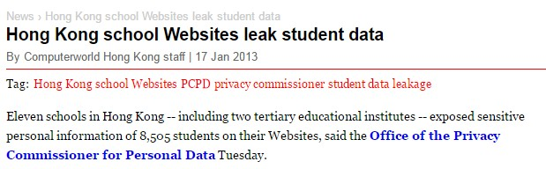
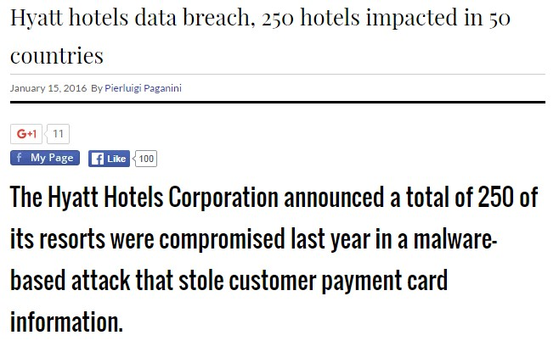

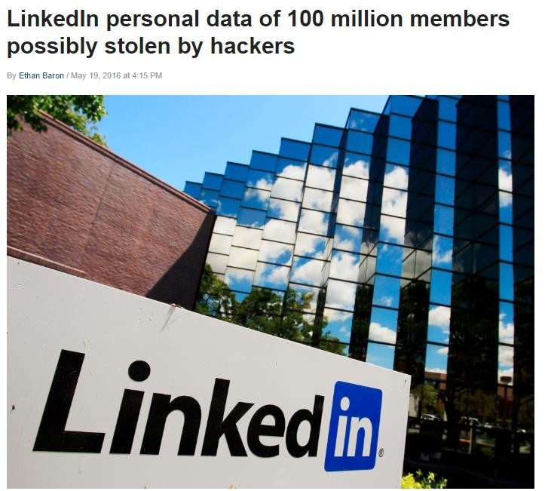

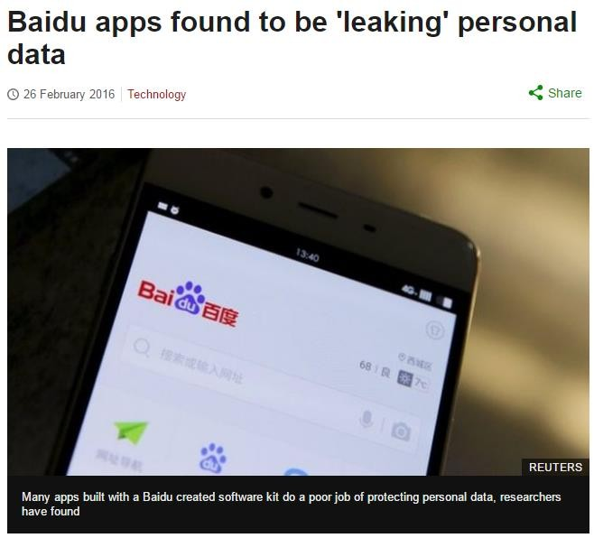

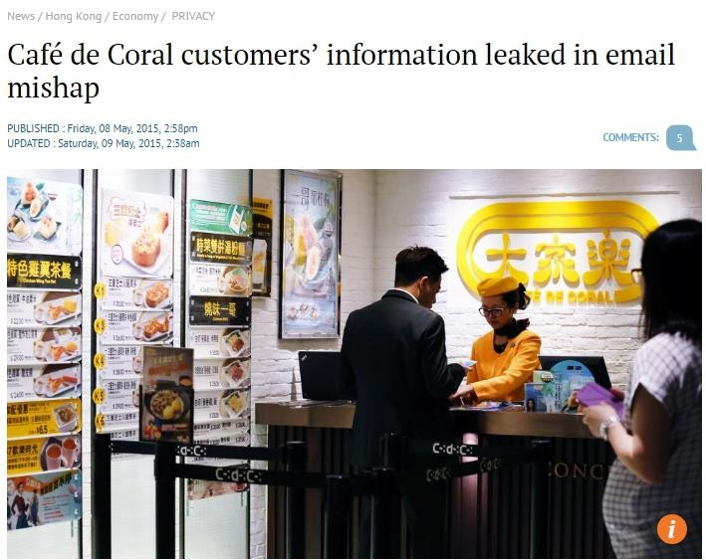

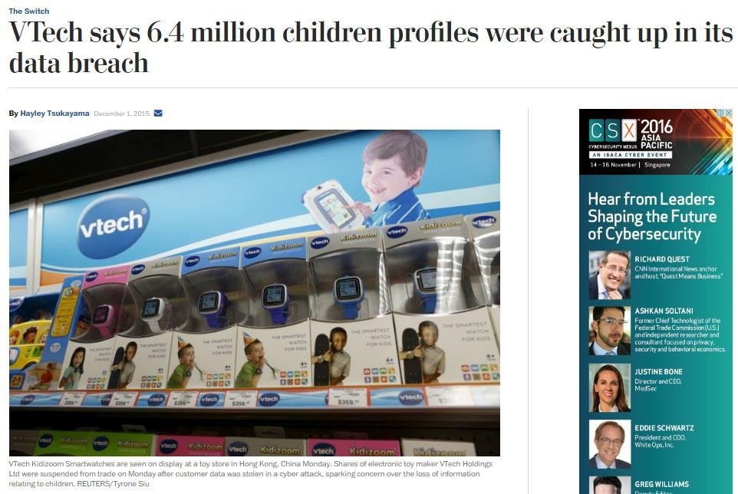


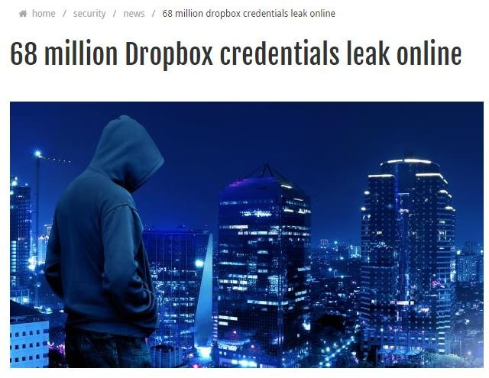
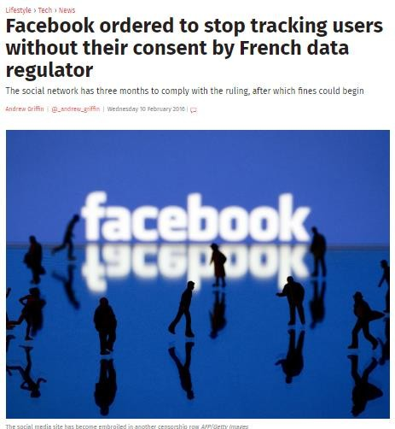

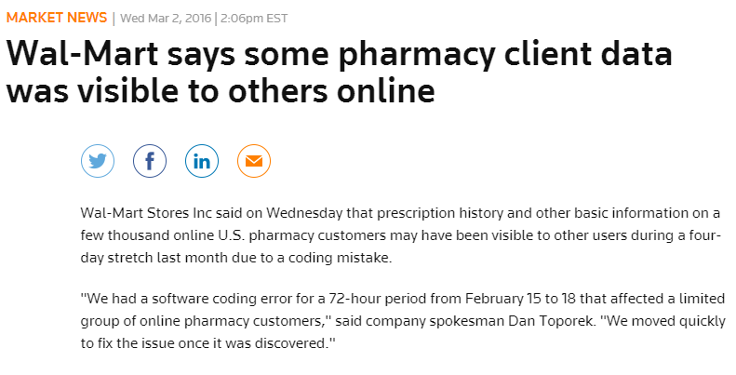

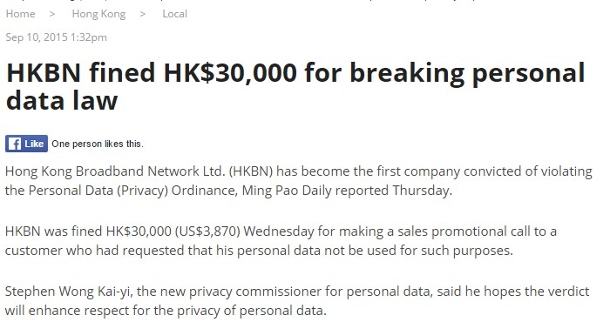
Recent News Headlines

Slide 6
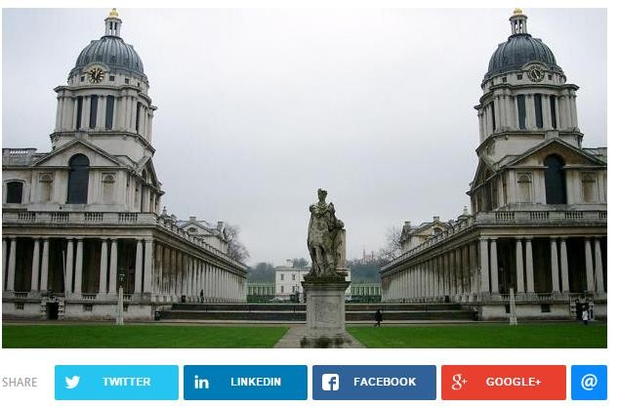
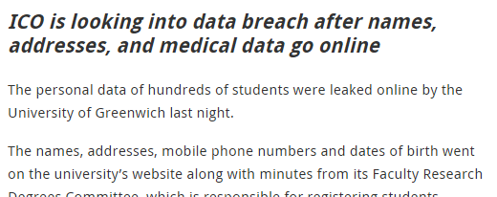
Recent News Headlines – Overseas Universities
Incident
Incident happened on 16 February 2016.
The personal data of hundreds of students were leaked online by the University of Greenwich.
Data: The names, addresses, mobile phone numbers and dates of birth, medical problems, students’ signatures, correspondence between university staff and students, and supervisors’ comments about students’ progress.
Action: The material has been removed from the website and contacted Google regarding removal of cached copies. The university has launched investigation after the breach.
Source: http://www.itpro.co.uk/data-protection/26058/university-of-greenwich-students-data-leaked-online

Slide 7
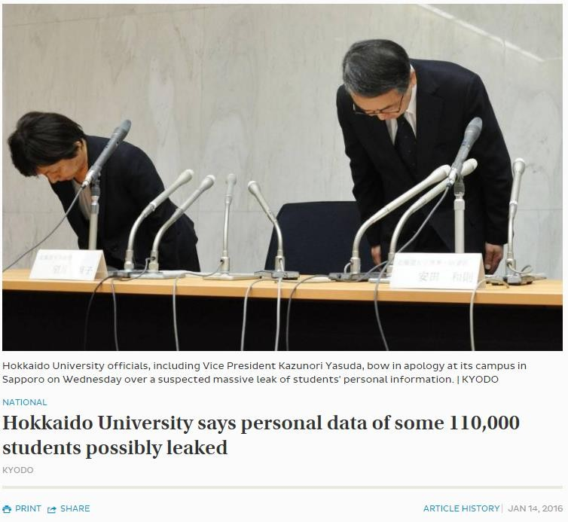
Recent News Headlines – Overseas Universities
Incident
Incident happened on 4 January 2016.
Data leaked due to unauthorised access of its computer systems by unknown parties.
Possible affected parties: 112,600 students
and graduates, and 1,600 companies
Data: Names, addresses and birth dates; companies information that used for recruitment
Action: The university set up a panel to investigate whether the data was actually leaked and whether the university has been managing personal data appropriately.
Source: http://www.japantimes.co.jp/news/2016/01/14/national/personal-data-of-110000-may-have-leaked-from-hokkaido- university/#.WAYBFfl96M8

Slide 8

Trends of Privacy Complaints in Hong Kong
Upward Trend in Privacy Complaints
No. of Complaint Cases
16%
2500
increased
2000
1500
1000
500
0
No. of complaint cases
Source: https://www.pcpd.org.hk/english/news_events/media_statements/press_20160126a.html

Slide 9
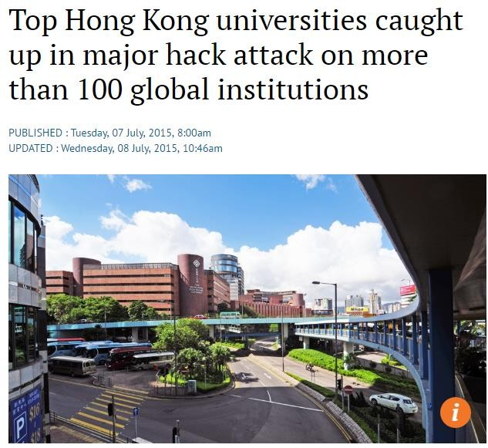
Recent News Headlines – Universities in Hong Kong
Incident
Incident happened in July 2015.
A major hack to a number of major educational institution in Hong Kong as Universities have many systems exposed to the Internet.
Affected Universities: PolyU, CUHK,
HKU Space, Hong Kong College of Technology. Thousands of user accounts were compromised in the wide ranging attack.
Data: Usernames, ID numbers, emails and phone numbers, Skype names, dates of birth, other personally identifiable information.
Action: Removal of defaced webpages and shutting down the server.
Source: http://www.scmp.com/tech/science-research/article/1833887/top-hong-kong-universities-caught-major-hack-attack-more-100

Slide 10

At this time of heightened public awareness of personal data
privacy, examples of questions to ask:
Is the existing governance structure sufficient and up to date?
Are our policies and procedures up-to-date and do our people understand and follow them?
?
Do you have effective solutions or measures in place to prevent or
Do we comply with the latest privacy legislation? Are we equipped to manage any changes?
Is our technology effective enough to safeguard our sensitive data?
Do we act responsibly and ethically provide our students, staff, alumni and guest with comfort that their personal data is not abused?
How do we increase our students, staff, alumni and guest’s confidence in the University when attention to personal data privacy issue is high?
minimise cyber attacks?

Slide 11
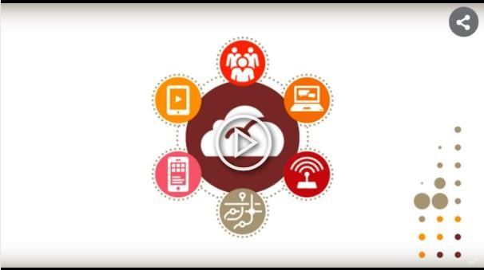
Video

Slide 12
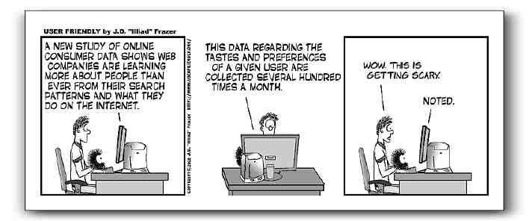
Do you really KNOW how much of your personal data is being
shared?

Slide 13
Section 2
The Personal Data (Privacy) Ordinance

Slide 14


What is Data Privacy?
Data Privacy
1.
Collection
It is the relationship between:
6.
Access &
Correction
2.
Accuracy & Retention
collection and dissemination of personally
identifiable information;
the individual’s expectation of protection
against unauthorized access; and
the associated technical, legal and regulatory requirements and issues.
DPPs
5.
Openness
3.
Use
4.
Security Measures
Personal Identifiers
Any piece of information that may be used to uniquely identify,
contact or locate an individual.
Name:_Chan Siu Ming HKID Card Number: Y0012xx(x)_ Address: Flat A, 5th Floor, XXX Court, Hong Kong _ Telephone number: _9222 XXXX Date of Birth: 8 November_19xx_

Slide 15

Personal Data (Privacy) Ordinance (“the Ordinance”)
An Ordinance to protect the privacy of individual in relation to personal data, and to provide for matters incidental thereto or connected therewith:
Protecting the privacy right of a “data subject” in respect of “personal data”, but not the general privacy
issues.
=
The living individual who is the subject of the “personal data” concerned.
Data Subject
Personal data should satisfy three conditions:
=
relating directly or indirectly to a living individual;
from which it is practicable for the identity of the
individual to be directly or indirectly ascertained; and
in a form in which “access to” or “processing of”
the data is practicable.
Personal Data
=
Any representation of information in any document, including expression of opinion or personal identifier.
Data

Slide 16
Quick polling – Which of the following documents are personal
data?
Teaching / Peer Evaluation Results
HKID Card number and passport details
Name and email
address
Address and personal
contact number
Research
questionnaire results
3. Examination transcripts
with student particulars
A. 2+4
B. 2+5
C. 2+4+5
D. 1+2+5
E. All of the above

Slide 17
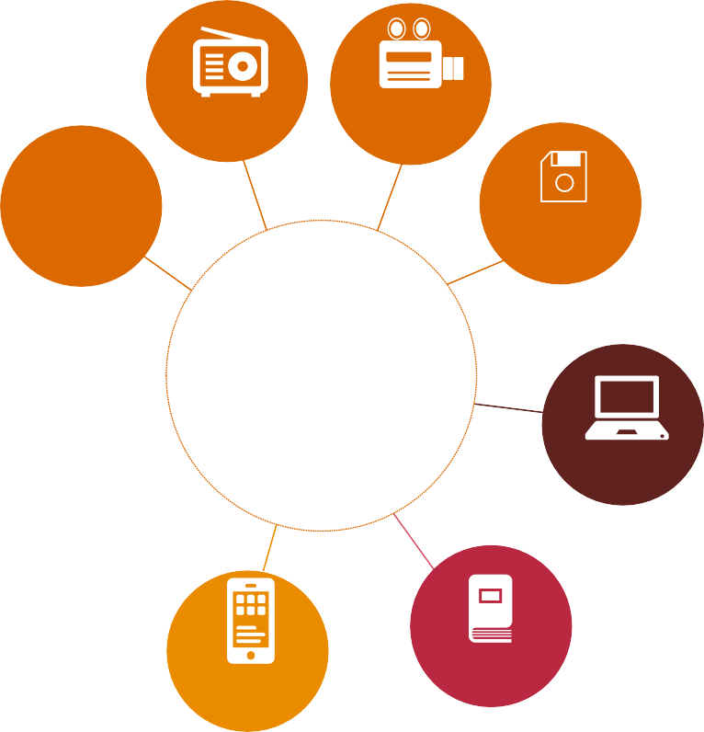

Definitions under the Ordinance
Document
Audio tape
Video tape
visual; or
non-visual device.
Photo
Optical disc
Documents
Data User
Laptop
Any person that controls:
Collection;
Holding;
Processing; or
Use of “personal data”.
Mobile device
USB
For example, the University, respective schools, faculties, and departments.

Slide 18





















The Six Data Protection Principles (“DPPs”)
DPP1 - Collection
for lawful purpose
avoid collecting excessive data
consequence of not providing such data
DPP2 - Accuracy & Retention
DPP6 -Access & Correction
• provides channel and rights for data subject to access and correct their own personal data
personal data should be accurate and up-to-date, do not keep longer than necessary
Data Protection
Principles
DPP5 - Openness & transparency of Privacy Policy
the kinds of personal data you hold and purpose for which data is being used
communicate externally & internally
DPP3 - Use
data collected can only be used for a specific purpose of collection
data subject’s consent is required for other or new purposes e.g. direct marketing / transfer etc.
DPP4 - Security Measures
personal data should be protected by appropriate and sufficient safeguards

Slide 19
Quick polling – Which of the DPP may be contravened if the
personal data of data subject are disclosed to third parties without their consent?
Collection of data – DPP1
Retention of data – DPP2
Use of data – DPP3
Security of data – DPP4
Source: https://www.pcpd.org.hk/misc/training/index.html

Slide 20
Quick polling – According to the requirements of DPP1 of the
Ordinance, which of the following shall be given to data subject when his/her personal data are collected by the data user?
Receipt
Personal Information Collection Statement
Personal Data (Privacy) Ordinance promotional leaflet
Complaint Methods
Source: https://www.pcpd.org.hk/misc/training/index.html

Slide 21
Quick polling – Personal data can be kept forever if there is a need
for my business to do so?
Yes
No
I don’t know

Slide 22
Quick polling – Which of the following item contravenes the
requirements of DPP4: security of personal data?
Mark “Confidential” on envelopes which contained important personal data
Strict access to confidential email account by authorised personnel only
Reuse documents containing personal data as recycle paper
Monitor the access of all sensitive personal data
Source: https://www.pcpd.org.hk/misc/training/index.html

Slide 23
Quick polling – Which of the following DPP is complied if a
company posts the privacy policy statement on its webpage?
Use of personal data – DPP3
Collection of personal data – DPP1
Security of personal data – DPP4
Information to be generally available – DPP5
Source: https://www.pcpd.org.hk/misc/training/index.html

Slide 24
Quick polling – As a data subject, can you request to access and/or
correct your own personal data held at the data user?
Yes
No
I don’t know

Slide 25
Key Highlights of the Amendment Ordinance
The Amendment Ordinance sets out more stringent rules to govern Direct Marketing
activities than under PD(P)O.
1
Direct marketing
offering or advertising of the availability of good, facilities or services OR
solicitation of donations or contributions for charity, political, etc. via mail, email, fax, phone call addressed to a specific person
New requirements for:
  Use of Personal Data for Direct Marketing
  Provision (i.e. transfer / sale) of Personal Data to Third Parties for Use in Direct
Marketing
Heavier penalty – fine of up to HK$1M & imprisonment for up to 5 years
Creates a new offence for the disclosure of personal data obtained without consent
2
Regulation of Data Processors
The Amendment effective date: 1 April 2013
3
Implementation of data user return scheme

Slide 26














Types of Direct Marketing
1. Use of personal data in direct marketing
Both types need to
adopt Opt-in model
Data Subject (Customer)
Provides personal data to data user
Data
User (Company)
Personal data used for DM e.g. sell fashion products
Personal Data
2. Provision of personal data for use in direct marketing
Data Subject (Customer)
Data User
(Company)
Transfer / sale of personal data
Provides personal data to data user
Third Party
Company
Personal data used for DM e.g. sell insurance products
Personal
Data
Personal
Data

Slide 27
Consequences of Non-compliance with Direct Marketing
Type of Non-Compliance | Maximum Fine (HK$) | Maximum Imprisonment
Non-Compliance | 500,000 | 3 years
Non-Compliance if the personal data is provided to third party for its use in direct marketing in exchange for gain | 1,000,000 | 5 years
Source: https://www.pcpd.org.hk/english/education_training/individuals/public_seminars/files/PDPO_Eng.pdf

Slide 28
Quick Polling – Are the following considered as direct marketing?
A
Person-to-person calls being made to phone numbers randomly generated
B
Mere notification of the expiry of existing services without offering new services
1. None
2. A only
3. B only
4. A+B
Source: https://www.pcpd.org.hk/english/publications/files/opt_out_e.pdf

Slide 29
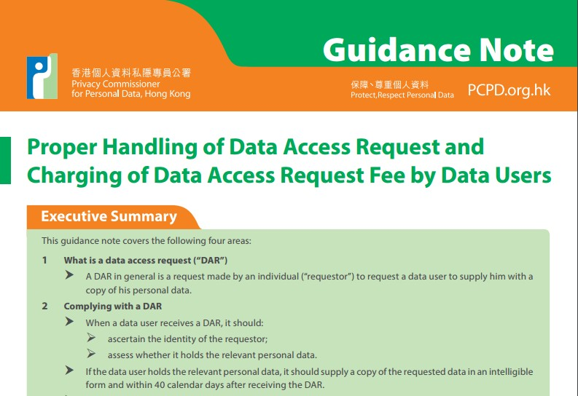
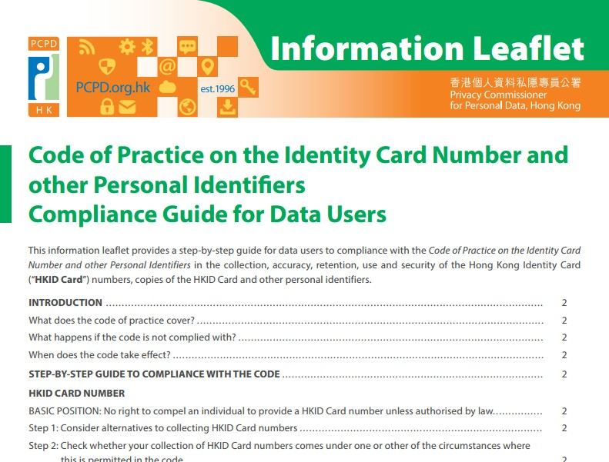
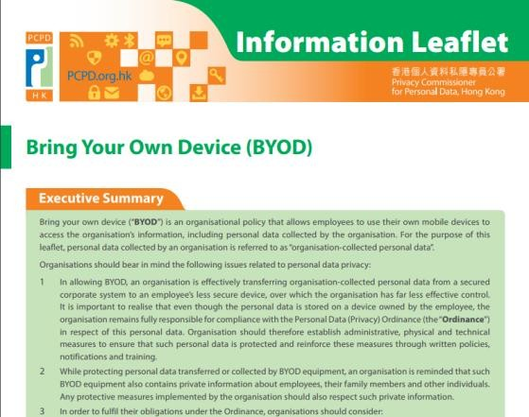
Key Updates on the related Guidance Notes and Information
Leaflets issued by the Commissioner
Code of Practice on the
Proper Handling of Data Access Request and Charging of Data Access Request Fee by Data Users
Identity Card Number and other Personal Identifiers: Compliance Guide for Data Users
Bring Your Own Device (BYOD)
Revised in June 2016
What is a Data Access Request (“DAR”)
Complying with a DAR
Charge for complying with a DAR
Refusing to comply with a DAR
Revised in July 2016
Collection, accuracy, retention, use and security of the HKID Card number and the copies of the HKID Card
No right to compel an individual to provide a HKID Card number or copies of HKID Card unless authorised by law
August 2016
Transferring organisation- collected personal data to employee’s less secured device
Protecting personal data of employees in their BYOD device
Obligations of organisations
Best practice for BYOD

Slide 30
Section 3
Application of the Six Data Protection
Principles (“DPPs”)

Slide 31
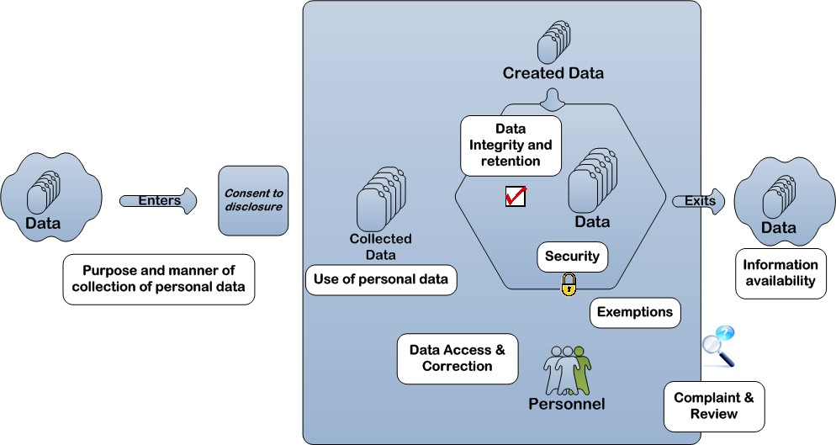
It is critical to understand what data is collected by each school / faculty / department and the lifecycle of that data within (and outside) the University.

Slide 32
Personal Information Collection Statement
During data collection, as a data subject, what do you want to know?
What kind of data?
What will the data to be used for?
Who will access the data?
Personal Information Collection Statement (“PICS”)
1
Obligatory or optional to provide data
2
Purpose Statement
3
Classes of transferees
4
Access & correction right

Slide 33
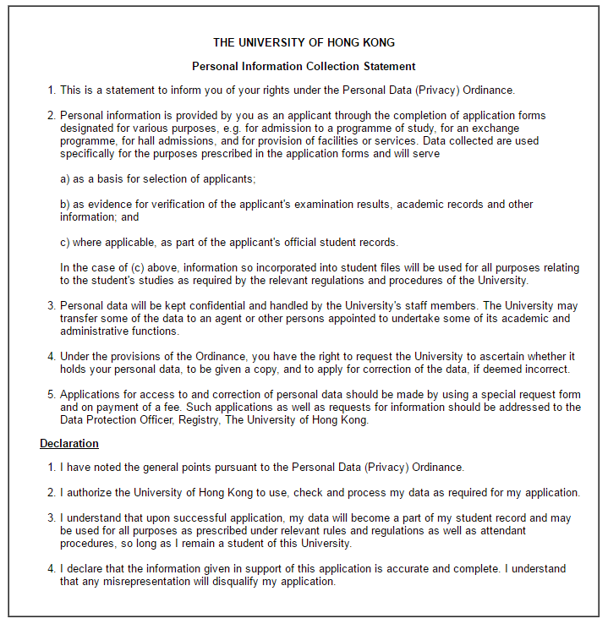
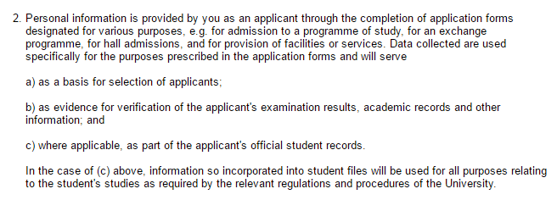
Sample of PICS – Application Form
1. Obligatory or optional to provide data Personal information is provided by you as an applicant through the completion of application forms designated for various purposes, e.g. for admission to a programme of study, for an exchange programme, for hall admissions, and for provision of facilities or services.
2. Purpose statement
Data collected are used specifically for the purposes prescribed in the application forms and will serve
as a basis for selection of applicants;
as evidence for verification of the applicant's examination results, academic records and other information; and
where applicable, as part of the applicant's official student records.

Slide 34
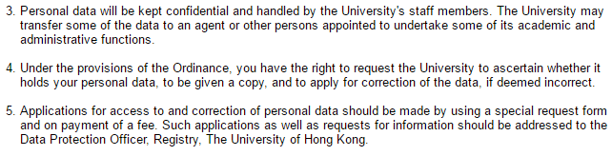
Sample of PICS – Application Form
3. Classes of transferees
Personal data will be kept confidential and handled by the University's staff members. The University may transfer some of the data to an agent or other persons appointed to undertake some of its academic and administrative functions.
4. Access and correction right
Under the provisions of the Ordinance, you have the right to request the University to ascertain whether it holds your personal data, to be given a copy, and to apply for correction of the data, if deemed incorrect.
Applications for access to and correction of personal data should be made by using a special request form and on payment of a fee. Such applications as well as requests for information should be addressed to the Data Protection Officer, Registry, The University of Hong Kong

Slide 35
Regulation of Data Processors
Data Processor
Equivalent to 3rd party service provider
A person who:
  processes personal data on behalf of the data user; and
  does not process the data for his/her own purposes.
Examples: invoice printing; mailing services; payroll processing
What if the data processor leaks out the data, who is responsible?
Requires data users to use contractual and other means to ensure that the personal data is protected from:
  Unauthorised or accidental access of personal data, processing, erasure, loss
or use of personal data transferred to the data processor for processing (DPP4 – Security of Personal Data)
  Not retaining for longer than necessary for the purpose of processing the data
(DPP2 – Accuracy & Retention)
What does this mean for your operations?

Slide 36
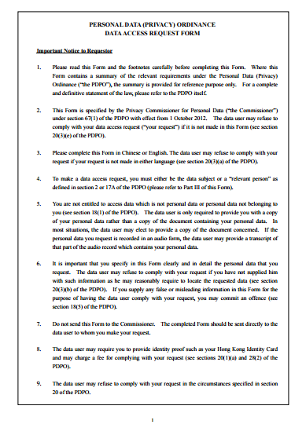
Rights of Data Access and Correction
Data Access & Correction
A data subject shall be entitled to
request access to his/her personal data;
request correction of his/her personal data.
Data user may charge a fee for complying with the data access request.
What is a proper handling procedure on access and correction request?
Data Access Request (“DAR”) Form
  Check the identity of the requestor
  Response to the DAR within 40 days
  Log the request
  Charge a reasonable fee
  If the University cannot comply and DAR within 40 days, should also provide a written notification to the requestor explaining the reasons

Slide 37
Data Breach Handling – How should we handle it
Data Breach
A data breach is
a breach of security of personal data held by a data user;
exposing the personal data to the risk of unauthorized or accidental access, processing,
use, modification or erasure.
Examples: loss of storage devices, improper handling or accidental transmission of personal data, database being hacked by outsiders, leakage of personal data caused by failure of computer systems
What should you do when you identify a data breach incident? As a data subject As a data user
Report the incident to the data protection officer
Provide relevant information and assistant to the investigation if needed
Assist to conduct investigation and recommend remedial follow-up actions
Report data breach incidents investigation results to the management
Act as the first line of contact for all data breach incidents

Slide 38
Case Scenario – No. 1
Background
An education institution has opened the admission application to the potential candidates.
During application submission, the institution has requested for the applicant’s information, including a copy of his/her HKID Card, contact number, address, date of birth, prior certificates / transcripts, etc.
The information collected is solely for processing the admission application.
However, the institution engaged in a practice of retaining personal data of unsuccessful
applicants for an indefinite period of time.
What do you think?
Which DPP(s) is/are involved?
Are the personal data collected appropriate?
What are some of privacy risk that the institution may be facing?
What should the institution be aware of retention of personal data?

Slide 39
Case Scenario – No. 1
VOTE NOW
Quick Polling
Which DPP(s) is/are involved?
DPP1 – Data Collection Principle
DPP2 – Accuracy & Retention Principle
DPP3 – Data Use Principle
DPP4 – Data Security Principle
DPP5 – Openness Principle
DPP6 – Data Access & Correction Principle

Slide 40
Case Scenario – No. 2
Background
Each semester, students are required to complete a course and teaching evaluation
questionnaire for each of the courses they are studying.
This requires them to rate both the course and the teacher’s performance.
It was agreed that the results are used by the Head of Department as part of the staff appraisal and development process and the overall assessment of the teacher's performance for each teacher is made available for inspection by the students on that course in the departmental office.
Students have requested greater access to the results (i.e. include publication of the results of replies to individual questions).
What do you think?
Which DPP(s) is/are involved?
Are the personal data disclosure appropriate?
What are some of privacy risk that the education institution may be facing?
What should the institution do to avoid contravention of the Ordinance?
Source: https://www.pcpd.org.hk/english/enforcement/case_notes/casenotes_2.php?id=1998E32&content_type=3&content_nature=33&msg_id2=23

Slide 41
Case Scenario – No. 2
VOTE NOW
Quick Polling
Which DPP(s) is/are involved?
DPP1 – Data Collection Principle
DPP2 – Accuracy & Retention Principle
DPP3 – Data Use Principle
DPP4 – Data Security Principle
DPP5 – Openness Principle
DPP6 – Data Access & Correction Principle

Slide 42
Section 4
Cybersecurity and Data Privacy

Slide 43
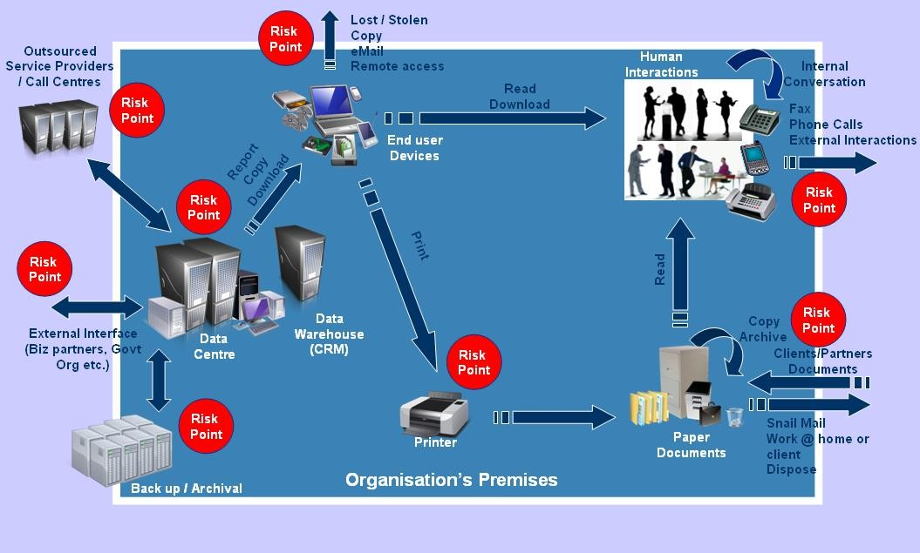
Security is fundamental in promoting data privacy, and with
today’s business information processing becomes much more complicated than a decade ago. A higher degree of processes automation brings higher information/ data leakage risks.
Network
DDDaaatttaaa
Application & Operating Systems

Slide 44
LIVE Hacking Demonstration

Slide 45
Section 5
Privacy Management Programme and Tips

Slide 46
What You Should Think About
Develop and maintain an effective privacy program / privacy data governance framework which provides oversight and control over the sensitive data lifecycle
Designation of a data privacy officer to handle privacy-related matters and carry our various privacy initiatives
Data foot printing, identification and taking stock of personal data being kept.
Understand all third parties that involved in data collection, processing, handling and storage of personal data and ensure the contracts with these providers have take into accounts the privacy requirements
Defining a privacy incident response and management procedure
Establishment and communication of internal policies regarding data privacy and security to guide employees on how sensitive data should be managed
Implement training on a regular basis to raise staff awareness
Conduct Privacy Impact Assessment (PIA) for new projects, or any change to relevant processes/systems to ensure appropriate measures are in place to protect and secure sensitive data

Slide 47
Privacy Management Programme
 | Selected B/Ds
Privacy Management Programme Attributes | 1. Organization Commitment | Buy-in from the top
 |  | Appoint Data Protection Officer / Data Protection Office
 |  | Establish internal reporting mechanisms (i.e. internal audit and assurance program to monitor compliance of data privacy policies
 | 2. Programme Controls | Maintain a Personal Data Inventory
 |  | Establish and documents key internal data privacy policies
 |  | Develop Risk Assessment Tools and perform regular review
 |  | Staff training and education
 |  | Establish Breach Handling procedure
 |  | Establish data processor management
 |  | Communications to employees and customers on personal data policies and practices
 | 3. On-going Assessment and Revision | Develop an oversight and revise plan
 |  | Periodic assess and revise program controls

Slide 48
Section 6
The System and Practices in the University

Slide 49
The System and Practices in the University
•
The Privacy Policy Statement (revised version 2015):
http://www.hku.hk/privacy_policy/
Code of Practice (revised version 2015): https://uis.hku.hk/web/gsabc/pdpo_cop.pdf
(including portable storage devices, incident handling / reporting and other guidelines)
•
•
Data Collection Statement
•
Statutory Data Access / Correction Request Process
•
University Data Protection Officer and Personal Data Protection Coordinators
•
Information Technology Services (advice / security measures / guidelines / training information): http://www.its.hku.hk/services/training/infosec/personal-data-protection
•
Central Compliance Team (compliance/monitoring)
Note: Information provided by HKU.

Slide 50



The System and Practices in the University
The Public Expectation
Awareness and Education
GOOD PRACTICE
Note: Information provided by HKU.

Slide 51
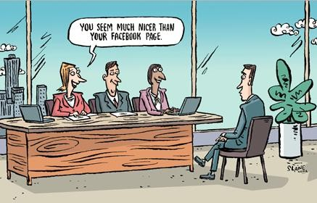
This is also your own responsibility…
Source: http://privacycartoonportfolio.blogspot.hk/

