Slide 1
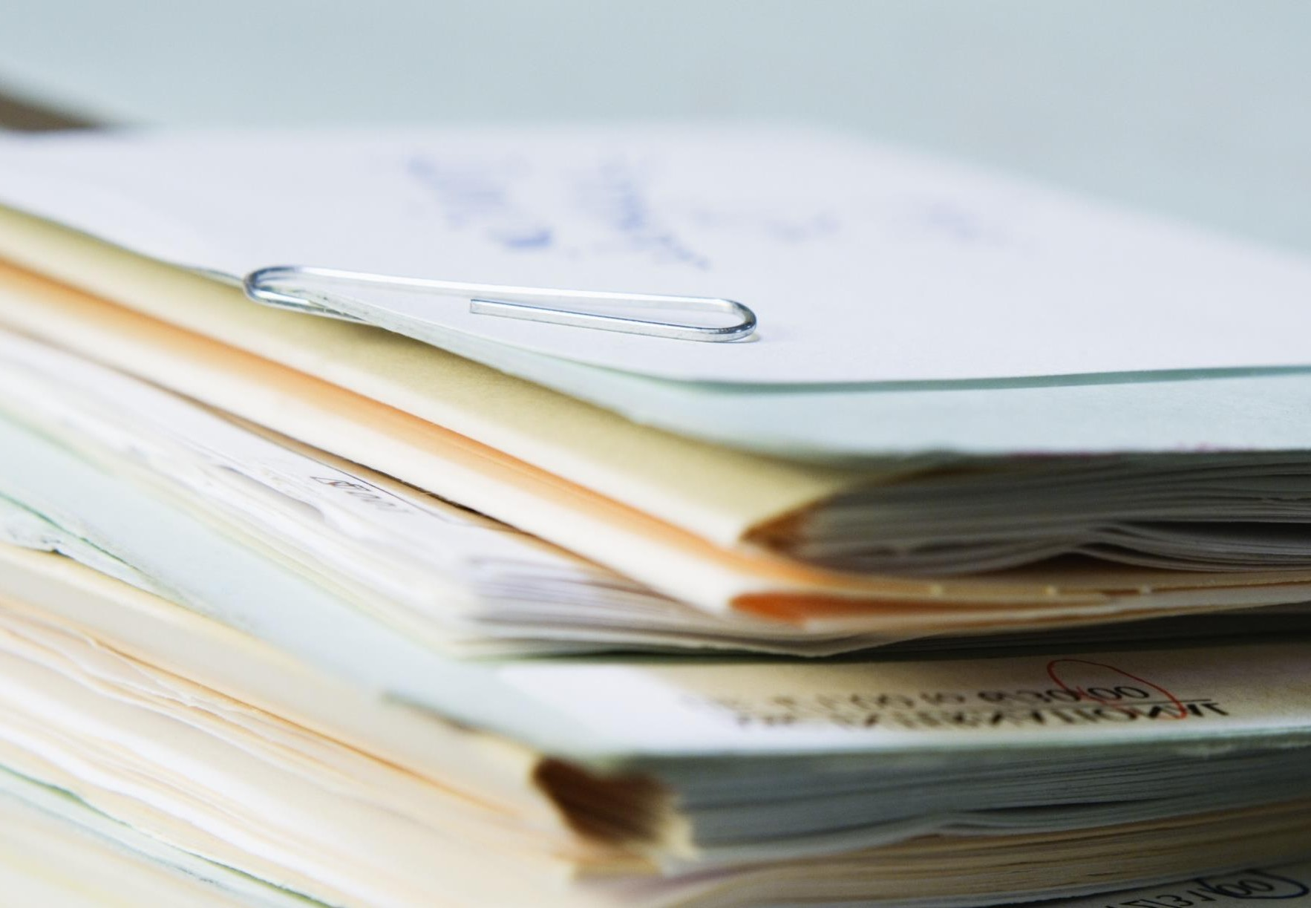

The University of Hong
Kong
Personal Data Protection and Security Measures
12 November 2015

Slide 2




Agenda
Overview of Privacy and Personal Data
Understanding of University Privacy Challenge
Personal data in universities
Roles and Responsibilities in Privacy and Personal Data Privacy Ordinance and Relevant Regulations
Hong Kong Personal Data (Privacy) Ordinance
Six data protection principles
Practicing the data protection principles
Privacy governance & privacy processes
Security Measures

Slide 3
Agenda
Overview of Privacy and Personal Data
Understanding of University Privacy Challenge
Personal data in universities
Roles and Responsibilities in Privacy and Personal Data Privacy Ordinance and Relevant Regulations
Hong Kong Personal Data (Privacy) Ordinance
Six data protection principles
Practicing the data protection principles
Privacy governance & privacy processes
Security Measures

Slide 4
Understanding of University Privacy Challenge
Internal and external factors affecting the implementation of an effective data privacy framework.
External Factors
Complex Data Structure
No centralised inventory for personal data maintained.
Evolving Regulatory Requirements
Complex data processing are difficult to understand the type of data it collects or held.
Internal Factors
Complex Data Structure
Inconsistent Policy
Lack of institutional-wide governing policy.
Inconsistent Policy
Weaken the governance on data privacy for institution as a whole.
Decentralised Implementation
Decentralised Implementation
Not clear who will be ultimately responsible for monitoring and
enforcing the compliance of requirements.
Actual Data Privacy Breaches
Hinders the implementation of relevant policies and procedures / controls.

Slide 5
Understanding of University Privacy Challenge
Actual Data Privacy Breaches
Data leakage has been a big concern for tertiary institutions in Hong Kong, as they handle mass volume of personal data (such as student / staff personal information and research subject data) in their operations. Personal data leakage results in negative effect on operation as well as institutions’ reputation. It is not uncommon to see names of tertiary institutions being featured in news related to data leakage incidents.
June
The system supporting a publicly available opinion collection programme of a university in HK has been hacked. Banking details, emails, home addresses and birth dates of more than 2,300 people may be leaked.
February
40 personal websites and almost 150 email accounts belonging to students and staffs of a university in Hong Kong have been hacked.
2009
2013
2015
2013
2014
June
A staff of a university in HK responsible for student recruitment of the 2 undergraduate programs accidentally attached a file containing personal data of 190 applicants to an email sent to 95 applicants.
July
Intruder targeted the master programme website of a university in Hong Kong used for the online submission of papers, and successfully stole names, login IDs, student and staff numbers, and email addresses.
March
A university in Hong Kong earlier found a link on a public website which provided access to documents containing staff donations, e-mail records and other related information. The document involved 110 organisations and individual donors, some of which involved personal data including the names of the donating agencies, individual names, addresses and contributions.

Slide 6
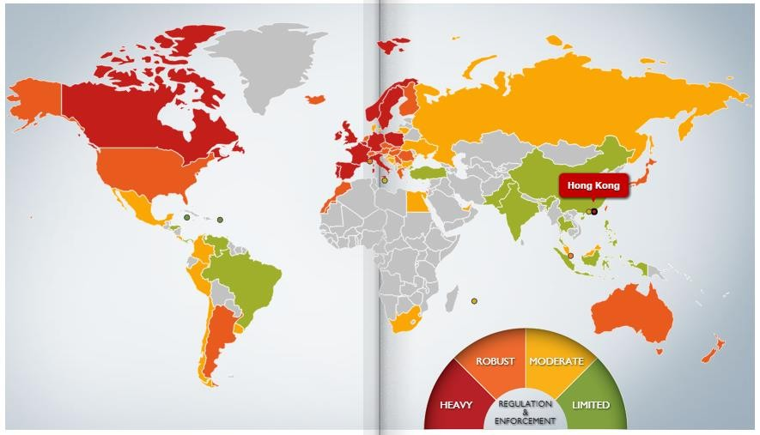
Data privacy around the world
(Courtesy of DLA Piper)
DLA Piper – Data Protection Laws of the world Link

Slide 7
Evolving Needs for Personal Data Protection
Time |  | Description
2010 | Jun | “Guidance on Data Breach Handling and the Giving of Breach Notifications” The following action plan is recommended for data user’s consideration: Step 1: Immediate gathering of essential information relating to the breach; Step 2: Adopting appropriate measures to contain the breach; Step 3: Assessing the risk of harm; Step 4: Considering the giving of data breach notification.
2012 | May | “Guidance on Collection of Fingerprint Data” Given the sensitive nature of fingerprint data, data users are encouraged to conduct a privacy impact assessment.
 | Dec | “Proper Handling of Data Correction Request by Data Users” According to the Personal Data (Privacy) Ordinance, DCR refers to data correction request. A data user is obliged to give written notice and reasons for refusal to the requestor within 40 days from receiving the DCR. A data user is required to keep a log entry containing the particulars of the reasons for the refusal of DCR for 4 years.
2013 | Jan | “New Guidance on Direct Marketing” It is provided that a data user must not use or provide personal data to another person for use in direct marketing unless it has obtained the data subject’s consent. Data users are required to inform the data subjects of the classes of marketing subjects in relation to which the data users are going to carry out direct marketing.
2014 | Feb | “Privacy Management Programme-A Best Practice Guide” Privacy Management Program is not a requirement under the Personal Data (Privacy) Ordinance. However, organisational data users are encouraged to embrace personal data privacy protection as part of their corporate governance responsibilities and apply them as a business imperative throughout the organisation.
 | Apr | “Guidance on Personal Data Erasure and Anonymisation” Data users must take all practicable steps to erase personal data held when the data is no longer required for the purpose which was used. Data users are required to take all practicable steps to ensure that personal data is not kept longer than is necessary for the fulfillment of the purpose which was used.
 | Jul | “Guidance on the Use of Portable Storage Devices” Data users are required to take all reasonably practicable steps to ensure that personal data held by it is protected against unauthorised or accidental access, processing, erasure, and loss. Data users should take steps to manage the security risks associated with the use of PSDs in order to comply with DPP4(1).
2015 | Mar | “Guidance on CCTV Surveillance and Use of Drones” Before using CCTV, data users should carry out a privacy impact assessment. CCTV cameras should be positioned in a way that will not unnecessarily intrude into the privacy of individuals. The personal data collected should be deleted from the CCTV as soon as practicable once the purpose of collection is fulfilled.
 |  |  | 6

Slide 8
Agenda
Overview of Privacy and Personal Data
Understanding of University Privacy Challenge
Personal data in universities
Roles and Responsibilities in Privacy and Personal Data Privacy Ordinance and Relevant Regulations
Hong Kong Personal Data (Privacy) Ordinance
Six data protection principles
Practicing the data protection principles
Privacy governance & privacy processes
Security Measures

Slide 9
Quiz module…
Which of the following is an example of personal information which can be used to
uniquely identify an individual?
Marital status
Address
Identity number
Race

Slide 10
Quiz module… (continued)
Is the following personal data?
a photo
IP address
License plate
Medical records
Employee number
Can you think of any other example?

Slide 11
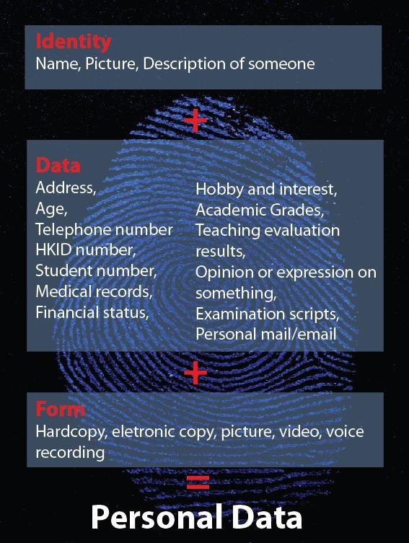
Overview of Privacy and Personal Data
Definition of Personal Data
• Relating directly or indirectly to a living individual
• From which it is practicable for the identity of the individual to be directly or indirectly ascertained
• In a form in which access to or processing of the data is practicable

Slide 12
Overview of Privacy and Personal Data
Personal Data in Universities
• Any data relating directly or indirectly to a living individual
• Name and HKID card number;
• Address and telephone number;
• Student number and examination transcripts;
• The details of your academic research project;
• Teaching evaluation results;
• Your opinion or expression in sensitive topics;
• Religious views;
• Medical records and financial status; and
• The personal data of others obtained through academic research (e.g. personal data obtained through surveys, interviews or other information gathering techniques).

Slide 13
Overview of Privacy and Personal Data
Definition of Privacy
• A concept applies to Data Subject (a living individual to whom personal data
relates)
• The agreed protection of personal data
• The right of an individual to decide who has access to his personal information and
how that information should be used
• Privacy not only guarantees the confidentiality of data, but also data’s level of
privacy

Slide 14
Agenda
Overview of Privacy and Personal Data
Understanding of University Privacy Challenge
Personal data in universities
Roles and Responsibilities in Privacy and Personal Data Privacy Ordinance and Relevant Regulations
Hong Kong Personal Data (Privacy) Ordinance
Six data protection principles
Practicing the data protection principles
Privacy governance & privacy processes
Security Measures

Slide 15
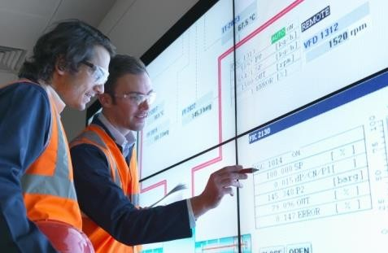



Roles and Responsibilities in Privacy and Personal Data
Owns the data. The Data Owner has the authority to decide how and why the personal information is to be processed
Data Owner
Data User
The individual about whom information is being processed
Personal Data
Data custodians Processes the data, within the boundries set by the Data Owner

Slide 16
Roles and Responsibilities in Privacy and Personal Data
Example – Roles and responsibilities of student records
• Data Owner
• Head of Student Records / Academic Secretariat
• Data Custodian
• Student Records Officer
• IT Officer
• Data User
• Administration Officer
• Professor

Slide 17
Roles and Responsibilities in Privacy and Personal Data
Data Owners
• Authority to collect, create, retain and maintain information and information
systems within their assigned area of control
• Usually senior personnel or faculty unit managers
• Responsibilities include:
• Assigning custody of the information
• Authorising access to the Information
• Specifying controls to ensure confidentiality, integrity and availability
• Communicating the control requirements to the data custodian and users of
the information

Slide 18
Roles and Responsibilities in Privacy and Personal Data
Data Custodians
• Responsible for the administration of controls as specified by the data owner
• Tasks include:
• Implementing physical and technical controls
• Administering access to information
• Ensuring the availability of information

Slide 19
Roles and Responsibilities in Privacy and Personal Data
Data Users
• Granted explicit authorisation by the relevant Data Owner to access, alter,
destroy, or use information within an information system
• Responsible for:
• Using the information only for the purpose intended by the owner
• Complying with all controls established by the owner and custodian
• Ensuring that classified or sensitive information is not disclosed to anyone
without permission of the owner

Slide 20
Agenda
Overview of Privacy and Personal Data
Understanding of University Privacy Challenge
Personal data in universities
Roles and Responsibilities in Privacy and Personal Data Privacy Ordinance and Relevant Regulations
Hong Kong Personal Data (Privacy) Ordinance
Six data protection principles
Practicing the data protection principles
Privacy governance & privacy processes
Security Measures

Slide 21
Privacy Ordinance and Relevant Regulations
Hong Kong Personal Data (Privacy) Ordinance
Objectives
To protect the privacy interests of living individuals in relation to personal data. It also contributes to Hong Kong's continued economic well being by safeguarding the free flow of personal data to Hong Kong from restrictions by countries that already have data protection laws.
Scope of Coverage
The Ordinance covers any data relating directly or indirectly to a living individual
(data subject)… It applies to any person (data user) that controls the collection,
holding, processing or use of personal data.

Slide 22


Information lifecycle management
The approach aims to gain an understanding of the risks associated with your information across its lifecycle.
Phase 4 – Transformation
Derivation
Aggregation
Phase 3 – Transfer
Phase 5 – Storage
Public versus Private Networks
Encryption
Requirements
Access Control
Access Control
Structured versus Unstructured
Integrity/Availability/Confidentiality
Encryption
Phase 6 – Archival
Lineage
Integrity
■
Phase 2 – Use
Internal versus External
Third Party
Appropriateness
Discovery/Subpoena
Compliance
Audit & Regulatory
Legal
Measurement
Business Objectives
Legal and Compliance
Offsite Considerations
Media Concerns
Retention
Phase 1 – Generation
Phase 7 – Destruction
Secure
Complete
Ownership
Classification
Governance

Slide 23
Privacy Ordinance and Relevant Regulations
The Six Data Protection Principles
• Principle 1: Purpose and manner of collection of personal data
• Collect personal data for a lawful purpose and by fair means
• Purpose of collection must be directly related to a function or activity of the data user
• No excessive collection of data

Slide 24
Privacy Ordinance and Relevant Regulations
The Six Data Protection Principles
• Principle 2: Accuracy and duration of retention of personal data
• Keep data accurate and up-to-date and no longer than its necessary period

Slide 25
Privacy Ordinance and Relevant Regulations
The Six Data Protection Principles
• Principle 3: Use of personal data
• Use data for the purpose stated at the time of collection or for a directly related purpose
• Principle 4: Security of personal data
• Apply appropriate safeguard for data protection
• Protect the data from unauthorised access

Slide 26
Privacy Ordinance and Relevant Regulations
The Six Data Protection Principles
• Principle 5: Information to be generally available
• Openness about what kind of data is held and the main purpose of use.
• Principle 6: Access to personal data
• Make data access and data correction requests in respect of individual’s
personal data

Slide 27
Agenda
Overview of Privacy and Personal Data
Understanding of University Privacy Challenge
Personal data in universities
Roles and Responsibilities in Privacy and Personal Data Privacy Ordinance and Relevant Regulations
Hong Kong Personal Data (Privacy) Ordinance
Six data protection principles
Practicing the data protection principles
Privacy governance & privacy processes
Security Measures

Slide 28











What could go wrong?
DPP2 – Accuracy & Retention Principle
DPP3 – Data Use Principle DPP5 – Openness Principle
Lack of ongoing quality control and improvement plan on the data accuracy of the Registration Forms and subsequent data amendments
Registration form not destroyed according to schedule
Lack of formal review of retention policies
across different divisions
Long data retention period for contractor
Absence of written guideline on
employer’s identity
the disclosure of
Collection
Retention
Use
Deletion
DPP1- Data Collection Principle
Unclear descriptions of type of personal data collected from job seeker and its purpose
DPP4 – Data Security Principle
Lack of physical access control
No departmental-wide guideline on disposal of equipment and IT security guideline
Insufficient measures for unauthorised access to
the CCTV system
Absence of written guidelines on the use of CCTV
No training plan on personal data protection
No written procedure and monitoring mechanism for the deletion of the personal data on share drive
Unauthorised login
Default password not required to change
What went wrong?
Example: Labour Department’s Personal
Data System for Job Seekers
Reference: PCPD Inspection Report issued 20 November 2014
© 2015 KPMG, a Hong Kong partnership and a member firm of the KPMG network of independent member firms affiliated with KPMG International Cooperative ("KPMG International"), a Swiss entity. All rights reserved. Printed in Hong Kong.
27

Slide 29
Practicing the data protection principles
Data Collection Statement
• Include a statement explaining the following when gathering personal data:
• What kind of data?
• What will the data to be used for?
• Who will access the data?
• Keep and use data strictly on necessary purpose especially for sensitive data

Slide 30
Practicing the data protection principles
Maintain Data Accuracy
• Keep all personal data up-to-date and accurate
• Responsibilities of staff
• Provide accurate and up-to-date personal information to the University
• Inform the University of any errors or changes to information which they have
provided

Slide 31
Practicing the data protection principles
Third Party Data Processor
• Establish a written contract on information confidentiality and security between
university and the third party processor
• Non-disclosure agreement
• Compliance with the Personal Data (Privacy) Ordinance
Individual Staff/ Student Rights
• Maintain an open attitude with staff/ students regarding the personal data being
held about them

Slide 32
Practicing the data protection principles
Records Handling
• Review files regularly and discard unnecessary or obsolete data
• Delete unnecessary electronic records
• Do not give away or sell university computers or data storage media without going through a proper disposal procedure
• Shred unnecessary paper records
• Dispose data securely
• Implement security measures to protect data (e.g. Locked file cabinets, password
and encryption, clean desk policy, etc)

Slide 33
Practicing the data protection principles
Data Disclosure
• Can only disclose student data to the 3rd party which is used for students’ studies
and to meet regulation requirements
• Handle all the requests for the personal data carefully and ensure they are genuine
and legitimate

Slide 34
Practicing the data protection principles
Research
• Personal data collected for research must comply with the university’s data
protection rules and the Personal Data (Privacy) Ordinance
• Examples:
• Do not keep personal data longer than is necessary for the purpose (Principle 2)
• Use the obtained personal data only for the purpose stated at the time of collection (Principle 3)
• Researcher should consider:
• Obtain minimum amount of data
• Clear academic objective?
• Security over data storage
• Duration of data retention period
• Anonymous data

Slide 35
Practicing the data protection principles
Marketing Information
• Always comply with the direct marketing provisions
• Do not disclose personal data to marketing organisation without permission from
data subject
• The personal data should only be used for the purpose stated at the time of
collection (Principle 3)

Slide 36
Practicing the data protection principles
• In general, the university should
• Always use student number instead of HKID number
• Provide guidelines and regular training to staff on personal data protection
• Always comply with the Personal Data (Privacy) Ordinance

Slide 37
Quiz module…
Personal data should be kept accurate, and in every instance, up to date. Is this statement True or False?
True
False

Slide 38
Quiz module… (continued)
When sharing personal data with third parties, what obligations must company XYZ ensure third parties comply with?
There are two correct answers.
The third party is obligated to take appropriate measures to protect the personal data.
The third party is obligated to destroy the information as soon as the contract is finished.
The third party is obligated to transfer all personal data received to the relevant governmental authority
There is an appropriate written agreement in place preventing the third party from using
the personal data except in accordance with instructions from Company XYZ.

Slide 39
Quiz module… (continued)
Throwing intact documents in the garbage or recycling is a secure means of disposal for personal data. Is this statement True or False?
True
False
How should you ensure that all personal data of a person or group of persons is really erased?

Slide 40
Agenda
Overview of Privacy and Personal Data
Understanding of University Privacy Challenge
Personal data in universities
Roles and Responsibilities in Privacy and Personal Data Privacy Ordinance and Relevant Regulations
Hong Kong Personal Data (Privacy) Ordinance
Six data protection principles
Practicing the data protection principles
Privacy governance & privacy processes
Security Measures

Slide 41

Privacy governance & privacy processes
Privacy Policies
& Strategy
Privacy
Operations
Business processes Information systems IT Infrastructure
Management Oversight
Monitoring/reporting
Audit
Dispute resolution
Privacy policy Governance structure Communication Training
Evolve Existing Governance Processes
Evolve Existing Oversight Processes
Evolve Existing Control Processes
Integrate
Integrate

Slide 42
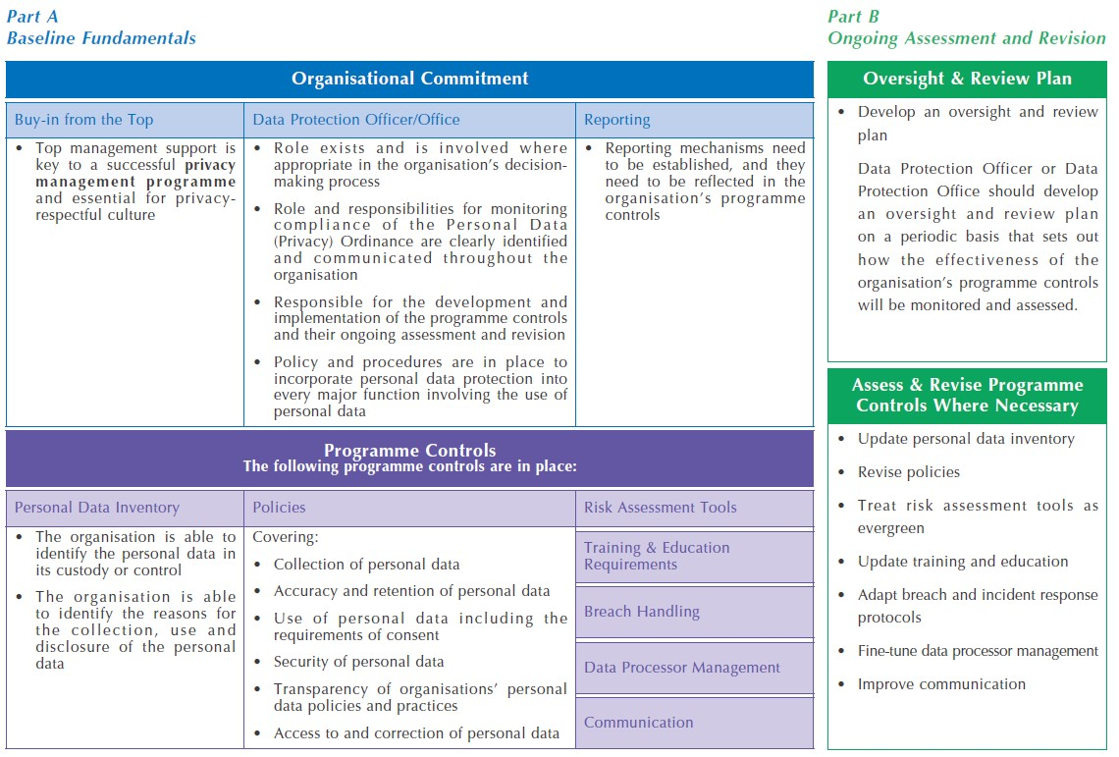
PCPD Privacy Management Programme

Slide 43
The value of a strong program
Reduce Errors & Mishandling
Increase Process Efficiency
Cultural Change/Accountability
Project Management
Sustain Compliance
Optimize Portfolio Management
Better
Reduce Litigation Costs
Lower IT Infrastructure Costs
Reduce Error Costs
Lower Audit Costs
Decrease Cost of Control
Lower Insurance Premiums
Cheaper
Reduce Implementation Time
Effective Communication and cooperation between business units
Streamline Acquisitions
Reduce Process Time
Information Sharing & Availability
Integrate Key Processes
Faster
Strengthen Processes/Controls
Reduce # of Vulnerabilities
Reduce Incident Costs
Information Ownership
Controls Across Lifecycle
Controls by Sensitivity
Controls Designed for Risk
More Secure

Slide 44
GAPP Privacy maturity overview
Level 5 Optimized
Level 4
Managed
Has fully implemented privacy program and has fostered a privacy culture organization-wide
Established privacy program; uses privacy enhancing tools and techniques, including addressing privacy risks.
Privacy Maturity
Level 3 Defined
Level 2
Repeatable
Established privacy policies that include
all business processes; has an awareness program and uses PIAs and compliance monitoring
Level 1 Ad Hoc
Recognize privacy as an issue; and has assigned responsibility and developed policies
Recognize privacy as an issue; but has not
developed privacy policies,
procedures and practices
Low
Information Accuracy and Organizational Confidence
High

Slide 45
The System and Practices in The University of Hong Kong
The Privacy Policy Statement (revised version 2015): http://www.hku.hk/privacy_policy/
Code of Practice (revised version 2015): https://uis.hku.hk/web/gsabc/pdpo_cop.p df (portable storage devices, incident handling / reporting and other guidelines)

Slide 46
The System and Practices in The University of Hong Kong
Data Collection Statement
Statutory Data Access / Correction Request
Process
University Data Protection Officer and Personal
Data Protection Coordinators
Information Technology Services (advice / security measures / guidelines / training information): http://www.its.hku.hk/services/training/infosec/pers onal-data-protection
Central Compliance Team (compliance/monitoring)

Slide 47
Agenda
Overview of Privacy and Personal Data
Understanding of University Privacy Challenge
Personal data in universities
Roles and Responsibilities in Privacy and Personal Data Privacy Ordinance and Relevant Regulations
Hong Kong Personal Data (Privacy) Ordinance
Six data protection principles
Practicing the data protection principles
Privacy governance & privacy processes
Security Measures

Slide 48
Privacy vs. IT security
“You can have security without privacy, but you cannot have privacy without security!”
IT Security
Privacy
Security organisation
Personnel security
IT Services Mgmt.
System development
Privacy Policy
Notification
Subject rights
Purpose binding
Proportionality
Data quality
Lawful transfer
Security Policy
Classification
Logical security
Physical security
Availability
Compliance
Incident management
Physical controls
Technical controls
Admin. controls

Slide 49
Sensitive data flows – Market observations
• Data transfer management capabilities decentralized
• Inventory of sensitive data flows doesn’t exist and is immature
• Lines of departments and IT aren’t coordinated on what types of sensitive data are being transmitted and where the data is being transferred
• Large volumes of paper with sensitive data elements are being created during routine departmental processes
• Electronic sensitive data transmissions occur in multiple ways (FTP, NDM)
• Enterprise control frameworks aren’t mature enough to account, monitor,
and report on sensitive data flows
• Removable media (CD/DVD, USB Drives, Tapes) are pervasive throughout the
environment and technology controls are playing catch up
• Reactive approach to protecting data, by responding after a breach occurs
• Breach notification plans aren’t fully mature to anticipate notification requirements based upon sensitive data elements present

Slide 50
Protecting Data while surfing the Internet
Recommendations on using shared computer
(Shared computers include public computers in the library, computer labs,
canteens and other public areas.)
• Don’t check the "Remember My ID" box;
• Don’t save passwords;
• Always remember to logoff using the logoff button;
• Get into the habit of changing passwords frequently (at least every 180 days);
• Delete the contents of the browser's cache;
• Don’t trust the bookmark of the browser, always key in the URL;
• Don't login to a computer and leave it unattended; and
• Avoid transactions involving financial data.
BEST PRACTICE: Do not login to any website (e.g. student registrar, bank account, email) unless absolutely necessary.

Slide 51
Protecting Data while surfing the Internet
Recommendations on using personal computer
(Personal computers include the computer at your workplace or any personal
computer used solely by yourself)
• Install security patches to your system (e.g. Windows service pack)
• Use encryption to protect sensitive data in portable drive (USB drive), e.g. Data
Leakage Prevention (DLP) software provided by the institution
• Use anti-virus and anti-spyware in your computer;
• Do not provide personal information to untrusted or suspicious website;
• Be skeptical, do not download any suspicious attachments provided by anyone;
• Always consult IT helpdesk when in doubt about suspicious links and attachments;
• Do not download pirated material, including music and video, as they may trick you
to install malware to play them; and
• Log out or lock your computer when left unattended.

Slide 52
Summary
Overview of Privacy and Personal Data
Understanding of University Privacy Challenge
Personal data in universities
Roles and Responsibilities in Privacy and Personal Data Privacy Ordinance and Relevant Regulations
Hong Kong Personal Data (Privacy) Ordinance
Six data protection principles
Practicing the data protection principles
Privacy governance & privacy processes
Security Measures

Slide 53

Q&A
₅₂ 52
Q&A

